Slide 1
John 2: 1-11
Jesus turns water
into wine

Slide 2
Wedding
invitation

Slide 3
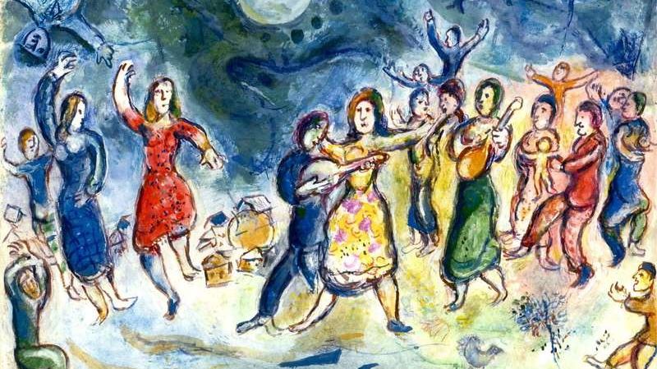

Slide 4
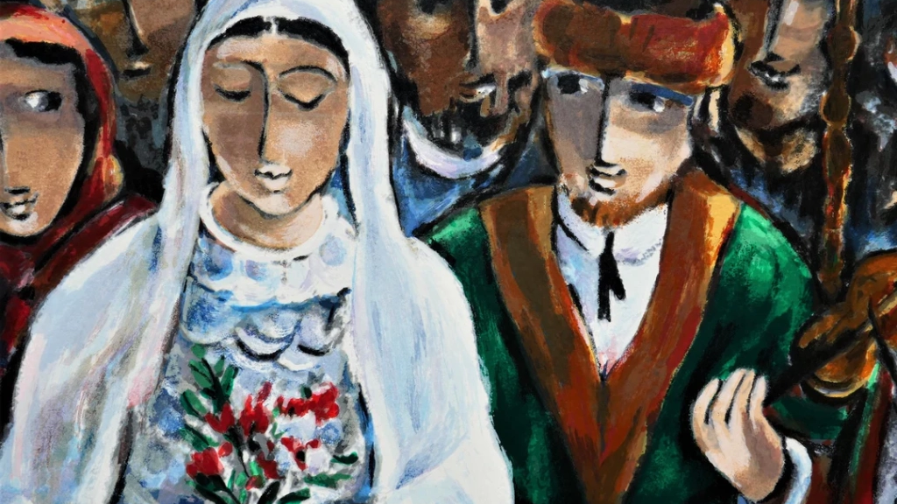

Slide 5
No more wine!

Slide 6
